Slide 1
Just Another Movie
Robert Jones, Emmett Storey, Kaitlyn Hardin, and Hayden Richard
*Just Another Movie is A movie recommendation system.

Slide 2


Outline
Frontend
Backend
AI
Database

Slide 3
Frontend
Used to gather information from a user at the initial startup
Requirement
Errors Checked
Invalid Searches
Invalid Symbols (/,?)
Unknown information in the dataset

Slide 4
Invalid Symbol
Some symbol such as ‘}’ or ‘&’ will cause the system to give an error message.

Slide 5
Unknown information in Database
EX:Movies that are not within the database.
as a result, this will cause the system to produce an error Message.

Slide 6
Backend
The Backend interacts with the A.I. and Frontend.
The Backend must be able to output the list of movies received from the A.I. to the Frontend.

Slide 7

AI
Creating and training the AI
Load Test Data
Build and Train model
Evaluate Model
Save and use model
This Photo by Unknown Author is licensed under CC BY

Slide 8
AI: Load And Test Data
userID | movieID | userRating
1 | 3 | 4
2 | 5 | 5
3 | 2 | 5
To train the AI we will need to load the testing data from the SQL server.
We need to put the data into a csv format, the data we primarily need is userID, movieID, and userRating.

Slide 9
AI: Build and Train Model
 | Movie1 | Movie2 | Movie3
User1 | liked | liked | liked
User2 | liked | Hasn’t seen | liked
For our model we are going to use matrix factorization to generate movie recommendations.
Matrix factorization uses collaborative filtering to be able to generate movie recommendations.

Slide 10
AI: Evaluate Model
Once the model has been training for a while, it will be time to check the output and to make sure it is giving good recommendations.
We can look at the accuracy of the output by looking at the R squared value.

Slide 11
AI: Save and Use Model
Once the model is giving good recommendations and cannot be improved anymore, it will be time to save the state of the AI and use it in the application.

Slide 12
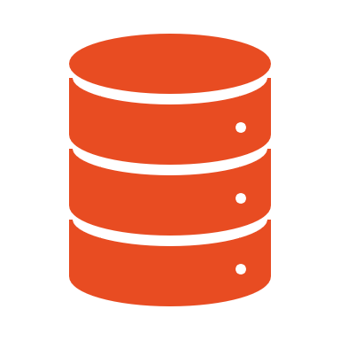
Database
Purpose is for data organization, storage, and control.

Slide 13
Database
Requirement:
Connecting MS SQL Server to the application for data manipulation.

Slide 14
Conclusion
Connecting server to application
AI training
Output movie list
Error checking

Slide 15

Thank You for Listening!

